Slide 1

TRIBAL TRANSPORTATION
Better Data Could Improve Road Management and Inform Indian Student Attendance Strategies (GAO-17-423)
https://youtu.be/RSc-R6Fg6Q4

Slide 2
School Bus on the Navajo Nation (Utah) and the National Rate of Students Chronically Absent, School Yr 2013-14

Slide 3

NTTFI Summary

Slide 4
Inaccuracies Limit Usefulness of NTTFI Data on Road Conditions
Several factors have affected data quality and usefulness
  Changes in how data are used for funding decisions
  Lack of clarity in BIA guidance for reporting data
  Limited data-monitoring activities
GAO Recommendations
  Reexamine need for data currently collected in the NTTFI and eliminate fields that do not serve an identified purpose
  For data determined to have continued relevance take steps to ensure that data are consistently reported
  Establish a process to monitor data to facilitate timely and targeted corrections to missing or erroneous data

Slide 5
DMR System Data Quality May Affect Reporting on Deferred Maintenance
Some data in BIA’s deferred maintenance reporting (DMR) system may be inaccurate
  Level of service (LOS) Date of update not recorded
  Cost of needed maintenance Lack of documentation
  Amount of maintenance performed Underreported
These deficiencies preclude a clear understanding of BIA road conditions and impair decisions about priorities and funding
GAO Recommendations
  Document when LOS for road sections were last evaluated
  Document unit costs of maintenance
  More accurate reporting of funds expended on maintenance

Slide 6
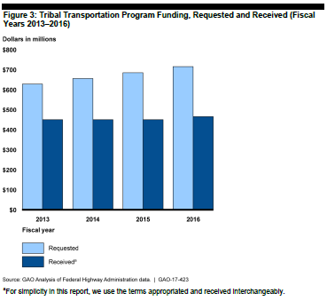
Challenges to Improving Roads
Funding Constraints
  Less frequent maintenance
  Greater future reconstruction costs
Overlapping Jurisdictions
  Checkerboard pattern of ownership
  Differences in priorities among road owners
Adverse Weather
  Geographic dispersion and land topography variation
  Greater impacts on larger reservations having more earth and gravel roads

Slide 7
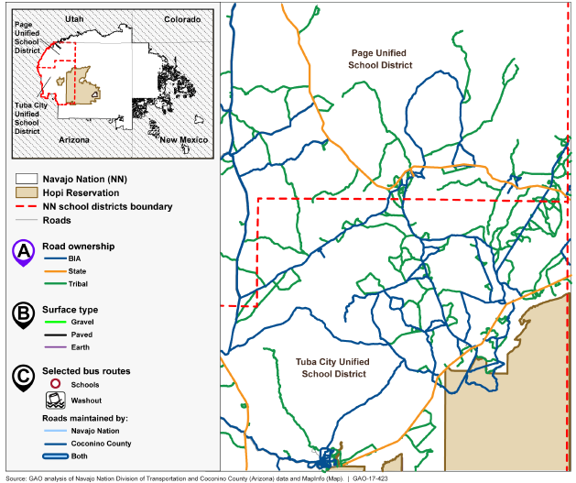
Jurisdiction Overlap: Road Ownership in Page and Tuba City Unified School Districts on the Navajo Nation in Arizona

Slide 8
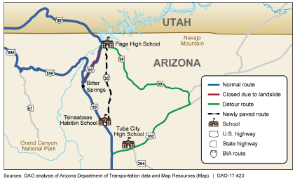
Partnerships Have Helped to Overcome Some Road Maintenance Challenges
Example:
FHWA, BIA, Arizona DOT, and Navajo Nation partnered on a $35 million emergency project
Project paved 27 miles of BIA Route 20 in 3 months following landslide damage to U.S. Hwy 89

Slide 9
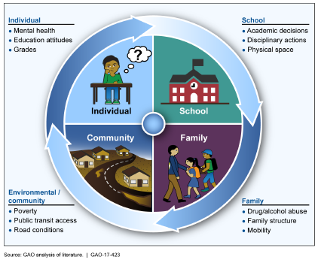
Road Conditions and School Attendance
Student attendance affected by individual, school, family, and environmental/community factors
Studies of developing countries indicate poor road conditions can decrease school attendance and road improvements can increase attendance

Slide 10
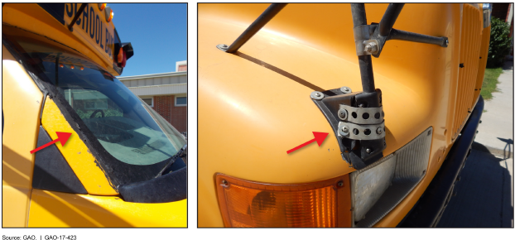
Schools Have Limited Data on Reasons for Absences
Bureau of Indian Education recently updated guidance—per GAO’s recommendation—to the 185 schools it funds to include road and weather conditions in their attendance systems
Such information should provide insight into the effect of roads and weather on absences and the ability to target interventions, such as allocating funding for bus maintenance (see photos)

Slide 11
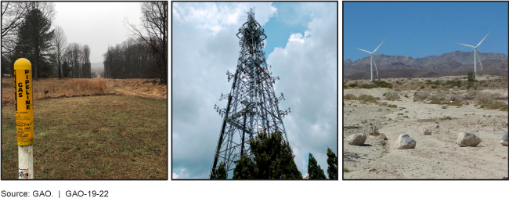
TRIBAL CONSULTATION
Additional Federal Actions Needed for Infrastructure Projects (GAO-19-22)

Slide 12
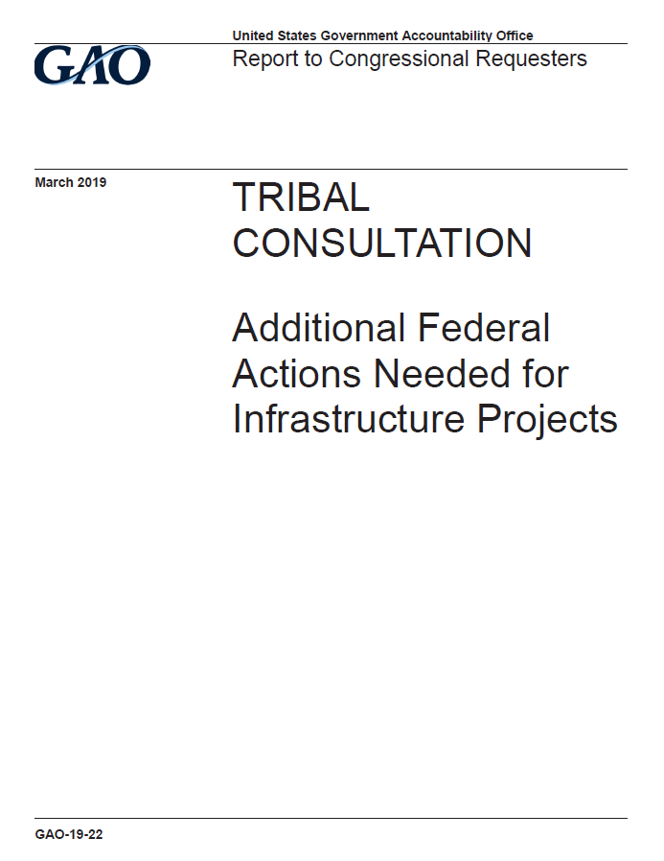
Tribal Consultation on Infrastructure Projects (GAO-19-22)
Objectives were to examine:
key factors tribes and selected federal agencies identified that hinder effective consultation on infrastructure projects;
the extent to which selected federal agencies have policies for consulting with Indian tribes and Alaska Native corporations on infrastructure projects and related activities;
steps selected federal agencies have taken to facilitate tribal consultation.

Slide 13
Scope and Methodology
Examined policies and interviewed officials from 21 federal agencies:
Army Corps of Engineers
Bureau of Land Management
Bureau of Ocean Energy Management
Bureau of Reclamation
Coast Guard
Department of Energy
Department of Housing and Urban Development
Environmental Protection Agency
Federal Aviation Administration
Federal Communications Commission
Federal Emergency Management Agency
Federal Energy Regulatory Commission
Federal Highway Administration
Federal Railroad Administration
Federal Transit Administration
Fish and Wildlife Service
Forest Service
National Oceanic and Atmospheric Administration
National Park Service
Nuclear Regulatory Commission
Rural Development
Summarized oral and written comments submitted by 100 tribes to federal agencies in 2016
Interviewed available officials from 57 tribes and 8 tribal organizations

Slide 14
Laws, Regulations, and Directives on Tribal Consultation for Infrastructure
Section 106 of the National Historic Preservation Act and its implementing regulations
National Environmental Policy Act implementing regulations
Executive Order 13175, Consultation and Coordination with Indian Tribal Governments (November 6, 2000)
Presidential Memorandum on Tribal Consultation (November 5, 2009)
Consolidated Appropriations Act, 2004 as amended

Slide 15
TRIBAL PERSECTIVES:
Areas Identified that Hinder Effective Consultation
1
Agencies’ processes for initiating consultation
2
Agencies’ practices for engaging with tribes to obtain and use their input
3
Agencies’ officials knowledge or training on tribal consultation
4
5
Agencies’ respect for Indian law and accountability
Tribal resources for participating in consultation

Slide 16
AGENCY PERSECTIVES:
Areas Identified that Hinder Effective Consultation
1
Initiating consultation when there may be tribal implications
2
Tribal participation in consultation and response to consultation notifications
3
4
Agency capacity to conduct tribal consultation
Interagency coordination on tribal consultation

Slide 17
Agencies’ tribal consultation policies
All 21 federal agencies reviewed have tribal consultation policies that cover infrastructure projects and related activities
Content of polices vary across agencies
Five agencies did not address required consultation with Alaska Native corporations (ANCs) in their policies or did not have a timeframe for doing so.
We recommended that these five agencies develop a documented policy or clarify existing policy to implement the statutory requirement to consult with ANCs, or establish a timeframe for doing so, as applicable.

Slide 18
Most agencies developed systems to help with initiating consultation
3 agencies developed information systems for identifying relevant tribes with tribes’ geographic areas of interest, and 18 agencies relied on multiple sources of information.
18 agencies have systems for notifying tribes that contain contact information for tribal leaders or other tribal officials.
Figure: Three Agencies’ Information Systems for Identifying
Tribes for Consultation on Proposed Infrastructure Projects

Slide 19
Need for a centralized information system for initiating consultation
Federal Permitting Improvement Steering Council (FPISC) recommended agencies develop a centralized information system, but there is no plan to establish one.
FPISC would also have to consider how to ensure the accuracy of information in the centralized system, including by coordinating with tribes.
We recommended that FPISC’s Executive Director should work with FPISC members to develop a plan to establish a central information system to help with initiating consultation.
We recommended that FPISC’s Executive Director should work collaboratively with FPISC members to consider how they will communicate with and involve tribes to help maintain accurate tribal data in the system.

Slide 20
Agencies use varying approaches to address communication with tribes
Most agencies (18 of 21) have tribal liaisons to facilitate communication with tribes.
Many agencies regularly meet with tribes outside consultation (14 of 21), or attend conferences or other tribal events (18 of 21) to maintain communication with tribes.
Many agencies (13 of 21) enter into agreements with tribes that outline agreed upon communication protocols.
Few agencies (5 of 21) have policies that call for communicating how tribal input was considered in agency decision making.
We recommended that the 16 agencies without such policies should document in the agency’s tribal consultation policy how agency officials are to communicate with tribes about how tribal input from consultation was considered in agency decisions on infrastructure projects.

Slide 21
GAO on the Web
Connect with GAO on LinkedIn, Facebook, Flickr, Twitter, YouTube and our Web site: https://www.gao.gov/
Subscribe to our RSS Feeds or E-mail Updates. Listen to our Podcasts and read The Watchblog
Congressional Relations
Orice Williams Brown, Managing Director, WilliamsO@gao.gov
(202) 512-4400, U.S. Government Accountability Office
441 G Street, NW, Room 7125, Washington, DC 20548
Public Affairs
Chuck Young, Managing Director, youngc1@gao.gov
(202) 512-4800, U.S. Government Accountability Office
441 G Street, NW, Room 7149, Washington, DC 20548
Strategic Planning and External Liaison
James-Christian Blockwood, Managing Director, spel@gao.gov
(202) 512-4707, U.S. Government Accountability Office,
441 G Street NW, Room 7814, Washington, DC 20548
Copyright
This is a work of the U.S. government and is not subject to copyright protection in the United States. The published product may be reproduced and distributed in its entirety without further permission from GAO. However, because this work may contain copyrighted images or other material, permission from the copyright holder may be necessary if you wish to reproduce this material separately.

