Slide 1
KIVALINA EVACUATION AND SCHOOL ACCESS ROAD
PRESENTED BY
MILLIE HAWLEY-TRIBAL ADMINISTRATOR
NATIVE VILLAGE OF KIVALINA

Slide 2
LEADERSHIP
Native Village of Kivalina – 7 members
City of Kivalina- 7 members
Local Borough
Kivalina Elders- 5 members
Local School District – 11 members
NANA Regional Corportation
State of Alaska Dept. of Transportation
FHWA

Slide 3
Community support
AEWC Whaling Captains
McQueen School Students
Parents of the McQueen School Students
Local Hunters and Food Harvest Gatherers
Local Church groups
Tribal Members living outside of Kivalina

Slide 4
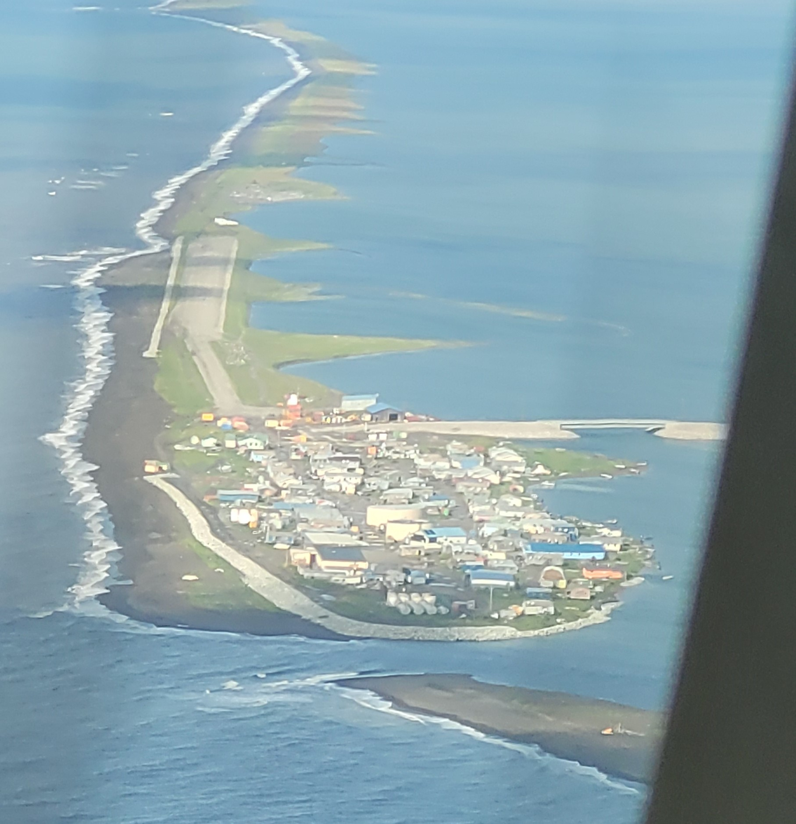
REASON
BEHIND
THE
ROAD!
SEVERE
EROSION
THREATENS
INFRASTUCTURE
WORSEN
FALL TIME
OCEAN
STORM
SURGES
LIFE
SAFETY
Kivalina, Alaska today
LAGOON BEACH NOT PROTECTED, NUMEROUS
HOMES AT RISK

Slide 5
Coordination of events
Local School District approached community November 28, 2011
Kivalina and 4 other rural villages won court decision for new school
Kivalina City posted a vote before the public January 3, 2012 which favored the road
EPA decision for an EA or EIS favored the EA which took 18 mos to complete
Local Borough, School District and Local leadership begin soliciting fund in FY15
Road contruction began 2017
Road completion October 2020 (State of AK funded a majority of the project, pass through funds from FHWA)

Slide 6
